Slide 1
Organizing Computer Facility
Centralized, Distributed, and Decentralized Computing Facilities

Slide 2
Introduction
Before the arising of the networks, we employed big data centers to process several batches of work in a centralized way.
In this scenario, operators manually make the machines ready to execute each work batch.
As the networks and the Internet got popular, we expanded the manners to provide computational services for the users.
Now, the client-server model is the most attractive option for implementing centralized computing.
Furthermore, distributed computing became a reality.

Slide 3
Centralized Computing
Currently, the most used model of centralized computing is the client-server model.
This model considers the existence of a server with large computational capabilities. This server, in turn, is the entity responsible for receiving requests and providing services for several users.
In other words, multiple clients share the same computational resources provided by a centralized server.
The number of clients answered in a certain period can be estimated through the total of computational resources available.
However, other operational characteristics of centralized systems are also important. Examples are their resource allocation and schedule algorithms. These algorithms define how and when to respond to specific requests.
We can have, for example, database servers that only save information periodically collected and do not interact with other systems.

Slide 4
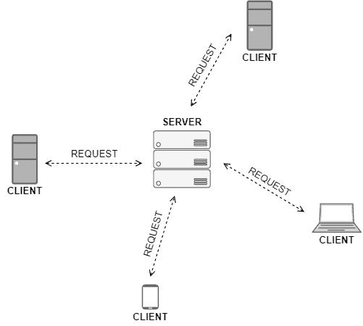
Centralized Computing
The image below shows a sketch example of a centralized system developed according to the client-server model

Slide 5
Components of Centralized System
Node (Computer, Mobile, etc.).
Server.
Communication link (Cables, Wi-Fi, etc.).

Slide 6
Advantages of Centralized Systems
The most interesting thing about centralized systems is the clear separation between servers and clients.
These entities are loosely coupled. In such a way, we can change the server without necessarily modifying the clients.
Furthermore, we can have different clients accessing the same server.
For example, the companies hosting servers can scale computational resources (such as memory or processing power) and make other types of maintenance in the server without modifications in the clients.

Slide 7
Advantages of Centralized Systems
Another interesting property is the client detaching from the server.
As a unique server provides all the services, detaching a particular client from them is easy: kill the client’s connection and block new ones through a firewall, for instance.

Slide 8
Disadvantages of Centralized Systems
The first potential problem is the limitation of the scaling-up process.
At some moment, only providing more resources for the server just doesn’t get its performance better.
There are other limitations, such as OS or network features, we can not resolve with extra computational resources.

Slide 9
Disadvantages of Centralized Systems
Another pitfall is that the server is a single point of failure.
In this way, if the server gets unavailable, the entire service downs even if all the clients are operational.
So, exploits, attacks, or any failure are potentially catastrophic.

Slide 10
Limitations of Centralized System
Can’t scale up vertically after a certain limit – After a limit, even if you increase the hardware and software capabilities of the server node, the performance will not increase appreciably leading to a cost/benefit ratio < 1.
Bottlenecks can appear when the traffic spikes – as the server can only have a finite number of open ports to which can listen to connections from client nodes. So, when high traffic occurs like a shopping sale, the server can essentially suffer a Denial-of-Service attack or Distributed Denial-of-Service attack.

Slide 11
Disadvantages of Centralized Systems
Highly dependent on the network connectivity – The system can fail if the nodes lose connectivity as there is only one central node.
No graceful degradation of the system – abrupt failure of the entire system
Less possibility of data backup. If the server node fails and there is no backup, you lose the data straight away
Difficult server maintenance – There is only one server node and due to availability reasons, it is inefficient and unprofessional to take the server down for maintenance. So, updates have to be done on-the-fly(hot updates) which is difficult and the system could break.
Single point of failure: Centralized systems have a single point of failure, which can cause the entire system to fail if the central node goes down.
Lack of transparency: Centralized systems lack transparency as the central authority has complete control over the system, which can lead to issues like censorship and bias.
Security risks: Centralized systems are more vulnerable to security risks as the central authority has complete access to all the data.
Limited scalability: Centralized systems have limited scalability as the central node can only handle a limited number of clients at a time.
Limited innovation: Centralized systems can stifle innovation as the central authority has complete control over the system, which can limit the scope for experimentation and creativity.

Slide 12
Applications of Centralized System –
Application development – Very easy to set up a central server and send client requests. Modern technology these days do come with default test servers which can be launched with a couple of commands. For example, Express server, Django server.
Data analysis – Easy to do data analysis when all the data is in one place and available for analysis
Personal computing
Use Cases –
Centralized databases – all the data in one server for use.
Single-player games like Need For Speed, GTA Vice City – an entire game in one system(commonly, a Personal Computer)
Application development by deploying test servers leading to easy debugging, easy deployment, easy simulation
Personal Computers

Slide 13
Applications of centralized computing
Although the pitfalls, centralized systems are good options for many applications. Currently, there are several off-the-shelf servers, such as web servers, launchable with few commands, making the deployment of new services easy.
Furthermore, we have multiple open-source data analysis tools for centralized services. These tools enable the owners of the servers to track what is happening with the provided services.
With the described scenario, we have the following examples of services that typically benefit from centralized systems: centralized databases, single-player games, and debugging sandboxes.

Slide 14
Distributed Computing
Distributed computing is a model in which components of a software system are shared among multiple computers to improve efficiency and performance.
According to the principles of distributed computing, systems should be scalable and able to handle increased loads effortlessly, by merely adding more machines to the network.
Distributed computing involves the simultaneous execution of a single task on multiple computers.
It distributes the load of processing across several nodes, thereby minimizing the chances of any single system becoming a bottleneck.
This model is especially effective for tasks that require a large amount of computational resources, or in environments where massive amounts of data need to be processed in a short time.

Slide 15
Distributed Computing
Distributed computing refers to having multiple components providing a service.
The components in a distributed system, in turn, must intercommunicate to exchange information and data.
This communication typically occurs by sending messages through a network.
It is relevant to highlight that when distributed entities make decisions on their own, the system is decentralized. However, when the entities coordinate in some way to make decisions, the system is a distributed system.

Slide 16
Types of distributed computing 1. N-Tier architecture
N-tier architecture in distributed computing refers to a multi-layered setup where application processing is separated into distinct layers or tiers, each potentially running on different physical servers. This architecture allows for more efficient distribution and scaling of tasks.
In a typical n-tier application, there might be a presentation tier (handling user interaction), an application logic tier (for processing data), and a data storage tier. This separation allows for load balancing and scaling each tier independently according to the computational needs.
For example, in an eCommerce platform, the application logic tier processes transactions and manages inventory, while the data storage tier handles database operations.
This distribution of tasks across multiple tiers and servers enhances performance and scalability, making it ideal for complex, large-scale distributed applications.

Slide 17
Types of distributed computing 2. Peer-to-Peer Architecture
In peer-to-peer (P2P) architecture within distributed computing, each node (or peer) in the network acts both as a client and a server, sharing resources and responsibilities.
This architecture is decentralized, meaning that tasks and data are distributed among all peers without a central coordinating server.
P2P is widely used in scenarios where data sharing and collaborative tasks are essential.
For instance, in file-sharing networks, each peer contributes by sharing files and also benefits by downloading from others.
In distributed computing, this model is advantageous for tasks like distributed data processing or collaborative scientific computations, where each node contributes processing power or data storage. P2P architecture provides robustness and scalability, as the system can easily adapt to the addition or removal of nodes, and there's no single point of failure, unlike client-server systems.

Slide 18
Distributed Computing
There exist different models of distributed computing.
For example, we can see the World Wide Web itself as a distributed system model.
However, the peer-to-peer model is an excellent one to explore the specific characteristics of distributed systems.
The peer-to-peer model consists of a collection of independent computers connected via a network. Each peer has enough capacity to process data and communicate with other peers, collaborating with a provided service.
In general, someone who wants to access the service communicates with one or more peers to get it. In particular cases, entities requesting the service also become peers providing the service.
So, the service organically grows: as bigger the number of entities requesting the service, the greater the service becomes.

Slide 19
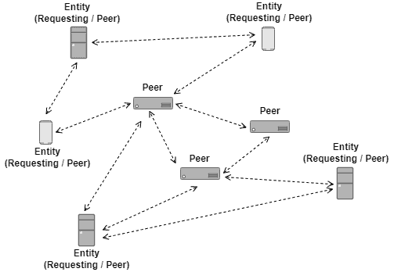
Distributed Computing
The image below exemplifies the presented characteristics of distributed computing in the peer-to-peer model:
Although distributed computing is a promising architecture in multiple aspects, it includes several challenges. Examples of such challenges are the coordination and the agreement of the distributed entities. Due to these challenges, distributed systems become a specific area in computer science

Slide 20
Advantages of Distributed Systems
One great benefit of adopting a distributed system is eliminating the single point of failure of centralized computing.
In distributed systems, a peer can fail and the service still available.
It means that other peers can assume the tasks of the peer that failed or, at least, properly inform the requesting entities that a particular peer failed.
In this way, we can understand a well-designed distributed system as a robust system.

Slide 21
Advantages of Distributed Systems
Another benefit of adopting distributed system consists of the scaling up and out processes.
So, we can add extra computational resources to the entities in the system (scaling-up). However, we can also add new entities to provide a service in the system (scaling out).
The possibility of adding new entities in the system enables the service providers to tackle specific necessities of particular geographical regions in different ways. For example, localities with a high density of service users can have several close providing entities.

Slide 22
disAdvantages of Distributed Systems
A relevant difficulty is the management of distributed systems.
As we have autonomous entities working together, it is hard to track and monitor each one.
Moreover, we must spread general updates to every entity providing the service, which requires a complex strategy. For instance, we need an update strategy to send and install patches in multiple destinations at a scheduled time.

Slide 23
disAdvantages of Distributed Systems
The different capacities and clocks of the entities in the system are another challenge.
Actually, it is not precisely a problem but a characteristic. However, the providers must balance the entities’ capacities, avoiding bottlenecks and underuse scenarios.
Regardless of the challenges, distributed systems have many different uses. For example:
BitTorrent Networks: distributed peer-to-peer networks to share data
Blockchain: decentralized and distributed databases where data is safely maintained by several entities

Slide 24
Applications of distributed computing 1. Artificial Intelligence and Machine Learning
Artificial Intelligence (AI) and Machine Learning (ML) are two of the most exciting and rapidly developing fields in technology today. They are also among the most notable use cases for distributed computing.
AI and ML algorithms require enormous amounts of data to train their models. Dealing with such vast amounts of data and performing complex computations is not feasible using traditional computing models. Therefore, distributed computing is used extensively in these fields.
One specific example of distributed computing in AI and ML is in training neural networks. Neural networks are a type of machine learning model that is inspired by the human brain. Training these networks involves processing vast amounts of data, which is distributed across multiple machines for faster computation. This distributed approach to machine learning is what makes it possible for us to train complex AI models in a reasonable amount of time.
Recommendation algorithms used by companies like Netflix and Amazon are deployed on distributed computing platforms. This allows these models to process millions of requests per second, providing personalized recommendations to users in real-time.

Slide 25
Applications of distributed computing 2. Scientific Research and High-Performance Computing (HPC)
Another area where distributed is used extensively is scientific research and high-performance computing (HPC). In these fields, distributed computing is used to solve complex scientific problems that require enormous computational resources.
For instance, distributed computing is used in the field of genomics to analyze large-scale DNA sequences. The Human Genome Project, which mapped the entire human genome, is a prime example of this. The project involved processing and analyzing vast amounts of genetic data, which was distributed across multiple machines for faster computation.
Similarly, distributed computing is used in climate modeling and weather forecasting. These simulations require processing massive amounts of data to make accurate predictions. This is achieved by distributing the data and computations across multiple machines, which allows for faster and more accurate modeling.
In the field of physics, distributed computing is used to simulate particle collisions in high-energy physics experiments. The Large Hadron Collider, the world's largest and most powerful particle accelerator, relies on distributed computing to process the vast amounts of data generated by its experiments.

Slide 26
Applications of distributed computing 3. Financial Services
In the financial services sector, distributed computing examples are plenty. Financial institutions deal with vast amounts of data, from customer transactions to market data. Processing and analyzing this data in real-time is critical to making informed decisions.
One notable example of distributed computing in financial services is in risk management. Financial institutions use distributed computing to analyze market data and calculate risk in real-time. This allows them to make informed decisions about investments and trading.
Additionally, distributed computing is used in fraud detection. By distributing data and computations across multiple machines, financial institutions can analyze transaction patterns in real-time and identify suspicious activity. This allows them to detect and prevent fraud more effectively.

Slide 27
Applications of distributed computing 4. Energy and Environment
Distributed computing is also used in the energy and environment sectors.
For example, it is used in smart grid technology to manage and optimize energy consumption.
Smart grids use distributed computing to collect data from various sources, such as smart meters and sensors. This data is then analyzed in real-time to optimize energy distribution and consumption. This not only improves energy efficiency but also enables the integration of renewable energy sources into the grid.
In the environmental sector, distributed computing is used in climate modeling and environmental monitoring. For instance, it is used to analyze satellite data to monitor environmental changes, such as deforestation and sea-level rise. By distributing these computations across multiple machines, scientists can process and analyze data more quickly and accurately.

Slide 28
Applications of distributed computing 5. Internet of Things (IoT)
The Internet of Things (IoT) is another area where distributed computing is utilized. IoT devices generate vast amounts of data, which need to be processed and analyzed in real-time.
Distributed computing is used in IoT to manage and process this data.
For instance, it is used in smart home systems to control and monitor various devices, such as thermostats and security systems. By distributing data and computations across multiple devices, these systems can operate more efficiently and effectively.
Moreover, distributed computing is used in industrial IoT applications, such as manufacturing and logistics. By distributing data and computations across various machines and sensors, companies can monitor and optimize their operations in real-time.

Slide 29
Applications of distributed computing 6. Blockchain and Cryptocurrencies
Finally, one of the most prominent distributed computing examples is blockchain and cryptocurrencies, two technologies that rely on distributed computing to operate.
In a blockchain, data is stored across a network of computers, each of which maintains a copy of the entire blockchain. This ensures that the data is secure and resistant to tampering.
In cryptocurrencies like Bitcoin, distributed computing is used to process transactions and maintain the blockchain. This involves solving complex mathematical problems, which are distributed across a network of computers. This distributed approach ensures that the system is secure and can handle a large volume of transactions.

Slide 30
Distributed computing from wikipedia
Distributed computing is a field of computer science that studies distributed systems, defined as computer systems whose inter-communicating components are located on different networked computers.
The components of a distributed system communicate and coordinate their actions by passing messages to one another in order to achieve a common goal.
Three significant challenges of distributed systems are: maintaining concurrency of components, overcoming the lack of a global clock, and managing the independent failure of components.
When a component of one system fails, the entire system does not fail.
Examples of distributed systems vary from SOA-based systems to massively multiplayer online games to peer-to-peer applications.

Slide 31
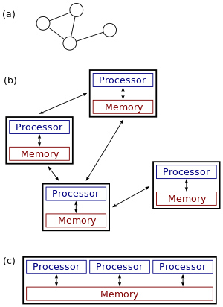
Parallel computing vs distributed computing
Distributed systems are groups of networked computers which share a common goal for their work. The terms "concurrent computing", "parallel computing", and "distributed computing" have much overlap, and no clear distinction exists between them.
Parallel computing may be seen as a particularly tightly coupled form of distributed computing which is considered loosely coupled.
In parallel computing, all processors may have access to a shared memory to exchange information between processors.
In distributed computing, each processor has its own private memory (distributed memory). Information is exchanged by passing messages between the processors.

